Slide 1
Responsible Adoption of LLMs in E-Business
Balancing Business Value and Governance
Zahra Ballaith
6th October 2025

Slide 2

Research Problem
Rapid adoption of LLMs in e-business (chatbots, personalization, automation)
Significant risks: bias, hallucinations, regulatory gaps
Lack of balanced frameworks integrating innovation & governance
Governance mechanisms remain underdeveloped, risking both compliance failures and erosion of customer trust.

Slide 3

Research Question & Objectives
Research Question:
How can e-businesses responsibly adopt LLMs to maximize business value while ensuring governance and ethical compliance?
Aim: To propose a balanced adoption framework that integrates business value creation with robust governance mechanisms.
Objectives:
1. Identify benefits & risks from literature.
2. Evaluate real-world cases of LLM use in
e-business.
3. Develop a balanced adoption framework.

Slide 4
Literature Review Themes
Business Value
Customer service automation
Personalization & engagement
Operational efficiency
Governance Challenges
Bias & fairness issues
Explainability & transparency
Compliance & regulation
Research Gap: Few integrative models balancing both dimension.

Slide 5

Critical Gap
Innovation-first vs Governance-first → polarized debate
Missing: practical, actionable framework for responsible adoption
Limited case evidence from e-business context
Most current governance frameworks are theoretical, with little evidence on business KPI integration.

Slide 6

Proposed Contribution
Balanced Adoption Framework (BAF)
Business Value ↔ Governance ↔ Practical Guidelines
Inform both practice (business adoption) & policy (regulation)
The Balanced Adoption Framework will serve as the artefacts produced through this research

Slide 7
Methodology
Phase 1
Phase 2
Phase 3
Systematic literature review (coding & synthesis)
Case studies of e-business LLM adoption
Thematic analysis & cross-case synthesis

Slide 8
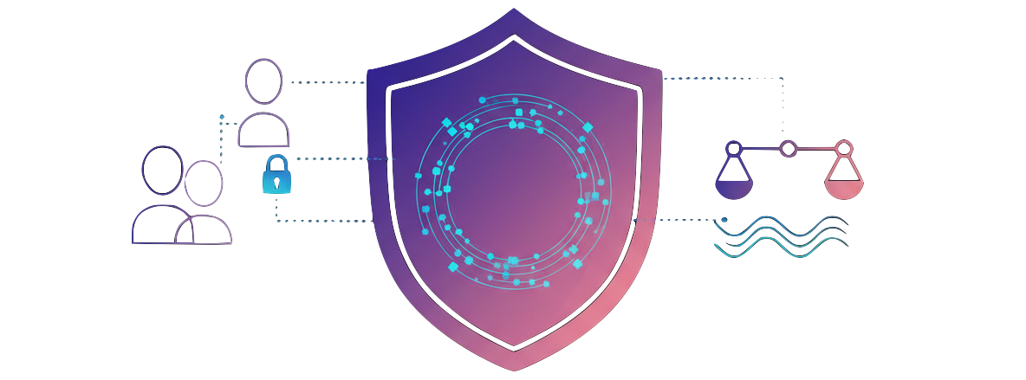
Ethical Considerations
Informed consent for interviews
Data confidentiality & anonymization
Researcher bias: mitigated via reflexivity and audit trails
Risk assessment:
Risk of reputational harm for participants
Risk of researcher bias (mitigated by reflexivity + audit trail)

Slide 9
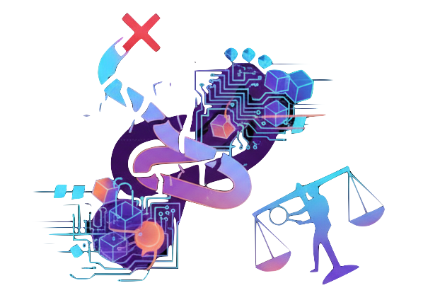
Limitations
Limited access to diverse e-business cases
Rapidly evolving AI landscape
Researcher position and bias
Potential researcher bias due to dual role as analyst and interpreter; mitigated through reflexivity, triangulation, and audit trails

Slide 10
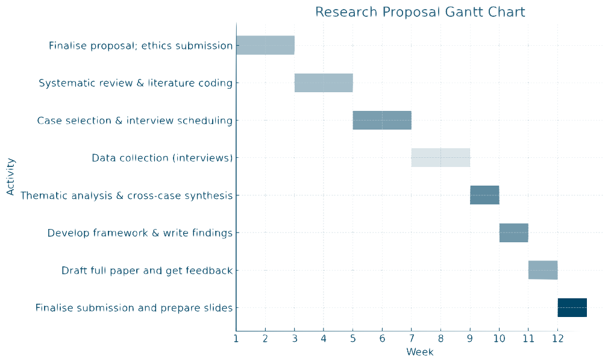
Timeline (Gantt Chart)

Slide 11

Expected Outcomes
Balanced Adoption Framework (BAF)
Contribution to Responsible AI governance
Practical insights for e-business leaders
Bridging the silos of business information systems and AI ethics by integrating value creation and governance into one unified model

Slide 12
Conclusion
Research Contribution
Balanced Adoption Framework linking KPIs to governance safeguards
Practitioner toolkit: checklists & monitoring metrics
Academic integration of business value + AI ethics
Future Outlook
Responsible adoption = sustainable innovation
Aligning innovation with governance builds trust & competitive advantage
LLMs = Opportunity + Challenge
Transformative potential in efficiency, scalability, and personalization
Significant governance risks: bias, privacy, explainability
Gap in Current Literature
Business benefits and governance risks often studied separately
Need for a unified approach

